Slide 1

WEB SCRAPING TO GAIN COMPANY INSIGHTS
For purposes of forage virtual work experience program
09-10-2023

Slide 2
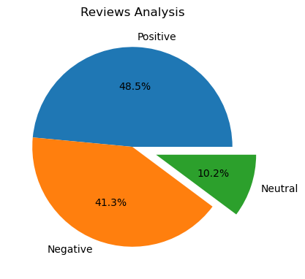
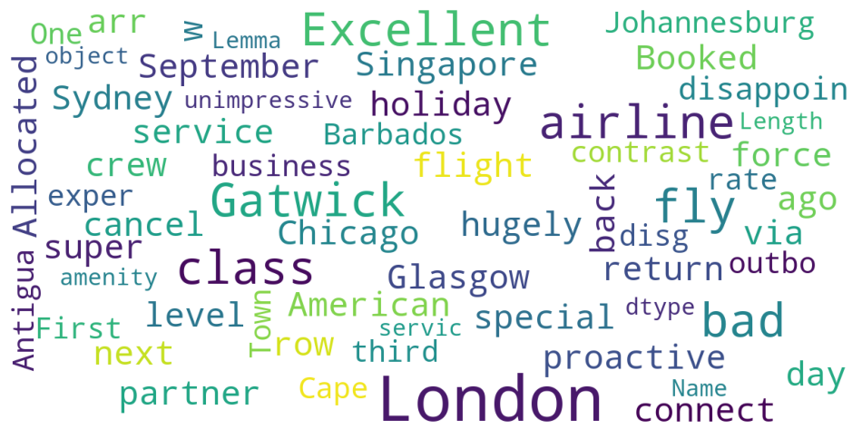
INSIGHTS FROM CUSTOMER REVIEW
BY CHECKING ALL 1000 REVIEWS OF THE CUSTOMERS WE OBTAINED
Positive Reviews - 485
Negative Reviews - 413
Neutral Reviews - 102
WORD CLOUD OF KEYWORDS USED IN REVIEWS

